Slide 1

Evaluating Road Safetey: A Predictive Algorithm for Accident Risk Levels
BY: Sasha, Mihai, Peter, Jonas, Sally

Slide 2
TABLE OF CONTENTS
01
02
04
Introduction
Methodology
Problem Statement
Data Desctription
05
06
08
Risk level
Legal equirments
03
07
Streamlit App
Figma
Design

Slide 3
INTRODUCTION
Objective: Integrate a predictive machine learning model into Google Maps to forecast road risk levels.
Implementation: Demonstrated through a Streamlit app and visualized integration plans using Figma.
Purpose: To equip drivers with real-time data, enhancing decision-making and aiming to reduce road accidents in Breda.
1
Notes:
Our project successfully enhances road safety by integrating a machine learning model with Google Maps to predict road risk levels—low, medium, or high. We developed a Streamlit app to demonstrate this functionality in real time, using historical data to assess risks accurately. Additionally, we utilized Figma to design how this model could seamlessly integrate into the Google Maps interface. This approach addresses the significant global issue of road safety, with statistics showing road traffic accidents causing approximately 1.2 million deaths annually. Our solution leverages machine learning to provide dynamic, real-time visual cues to drivers, thereby improving decision-making and reducing accident probabilities. The app and interface design illustrate the practical application and potential impact of our model on global road safety.

Slide 4
Problem statement
Global Crisis: Every year, road traffic accidents claim over 1.2 million lives globally, highlighting a critical need for enhanced road safety measures.
Rising Trends: Recent statistics from the Netherlands show a worrying 20% rise in road-related fatalities and serious injuries, indicating a growing problem.
Technological Gap: Current navigation technologies do not adequately predict or mitigate risks, necessitating advanced solutions for accurate road safety assessments.
2

Slide 5
Data Description
For our AI predictive algorithm for accident risk levels, we used two data sources:
ANWB Traffic Incidents Data, which contains important traffic related features like the duration of a incident or the longitude and latitude where the incident took place.
Breda Accident Data from 2017 to 2023, which contains useful information about the road condition and the weather related to accidents in Breda.
The aforementioned data enables a comprehensive risk assessment by enabling us to work with good, well structured data.
3

Slide 6
Methodology
Data Collection
For the data collection step, we joined the two datasets at our disposal, leaving us with the following features:
From the Breda Accidents Data:
Accident severity - target feature
First Mode of Transport
Area Type
Light condition
Road Location
Road condition
Road surface
Road situation
Speed limit
weather
accidents
From the ANWB Traffic Incidents Data:
Average longitude
Average latitude
4

Slide 7
Methodology
Data Preprocessing
For the Preprocessing step, we used the following methods to prepare data:
Missing Values Analysis. We conducted the missing value analysis by checking the data for missing values and then deciding whether the missing values bring any value to the project or if we should eliminate them from the data.
Outliers Analysis. We conducted outliers analysis by looking at each independent feature and establishing the frequency analysis, since most of the features use were categorical.
Label Encoding. We used label encoding for each categorical feature so that we can use the data to develop a model.
Standardization. We standardized the data so that it can be more interpretable for the model.
Random Oversampling. We used random oversampling to balance our target feature, since the three classes that were used for predicting were badly skewed.
5

Slide 8
Risk Level
High Risk Classification
EU AI Act identifies significant safety implications and data sensitivity.
Key Concerns
Risk Management Strategies
Safety Impact: Errors in predictions could lead to hazardous situations. Data Privacy: Compliance with GDPR is critical due to extensive data usage. Decision-Making Influence: Accuracy is vital as it affects driver and authority decisions.
Continuous Monitoring: Ensure system accuracy and reliability through regular updates. Legal Compliance: Adhere to data protection laws and AI safety regulations. User Transparency: Provide clear guidelines on system use and limitations to maintain user awareness.
6

Slide 9
Legal Requirements and Obligations
A
B
C
SEARCH THE Data Accuracy and Integrity (Article 10)
Documentation and Record-keeping (Article 12):
Transparency and Information Provision (Article 13):
Requirement: Use accurate, relevant, and representative data. Obligation: Regular validation and updating of data sources to prevent biases and ensure current, comprehensive data usage.
Requirement: Maintain detailed records of development processes, data handling, and testing methodologies. Obligation: Ensure documentation is available for audits and compliance, promoting transparency and accountability.
Requirement: Be transparent about functionalities, decision-making processes, and prediction methods. Obligation: Provide users with clear, accessible explanations of data use and prediction limitations.
7

Slide 10
Streamlit App
Google Maps Extesion Propsal
8

Slide 11

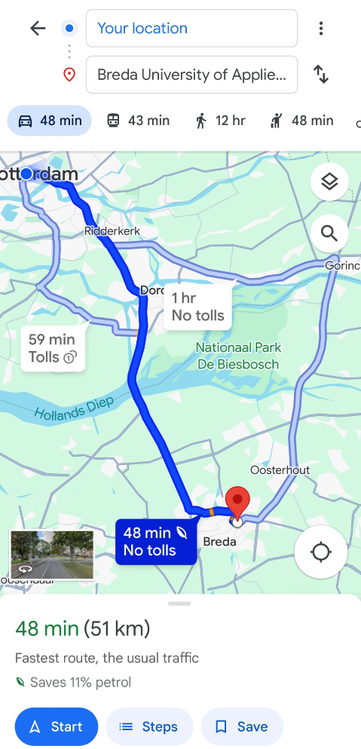
Figma Design
09
9

Slide 12
Thanks!
Do you have any questions?
10

